Slide 1
Students Learning about EU Values International Conference 16-17 November 2016, Ankara
“EU Values from the Perspective of a Citizen of a European Union Member State”
Mr. Anders Lönnqvist, Education Expert

Slide 2
European Values and the European Union
Most of you are familiar with European Values.
Good intentions, but Europeans have a long history of stabbing and shooting one another!
National identity links to culture and traditions, which are fundaments of the values shared by Europeans.
What are European values? Democracy, human rights, rule of law and solidarity are examples.

Slide 3
Perceptions about Europe
Many European young people think that ‘Europe is somewhere else.’ Not true! Europe is our home. But, with different perceptions about what Europe means and what it does.
What does the European Union mean for our everyday lives? Where is EU heading in a globalized world? What is the future for Europe, and EU?

Slide 5
Diversity within the European Union
Example of diversity in EU: there are so many different languages!
Most languages are related, but have own historical and cultural background and are seen as equally important.
This is also the case in Finland. I am a Finnish citizen, with Swedish as mother tongue. But I’m definitely a FINN. Especially in relation to ice hockey!

Slide 6
Perception of a EU citizen in an EU member country about the European Union
EU Member States are democracies, but there are differences about the specifics of the term.
Europeans agree on ‘human rights’, the refugee crisis causes divisions over universal rights.
Are values such as democracy, human rights, equality, solidarity enough to bind us together?
Or are there other equally important values?

Slide 8
Perception of an EU citizen
One of the EU values is about solidarity. Poor areas get more financial support. New member states get support to catch up with EU standards, including values.
Also when Finland joined EU: much support provided to agriculture (but also restrictions!), legislation, institutions etc.
And full access to the EU market!

Slide 9
Perception of an EU citizen
Values in Finland are related to fundamental rights, like the right to vote, to be equally treated by authorities, to travel and have access to education, the European job market
Values also linked to traditions, beliefs, religion, ethnicity, culture, politics etc.
I automatically think that these are also important for friends in other EU countries and I respect their values.

Slide 10
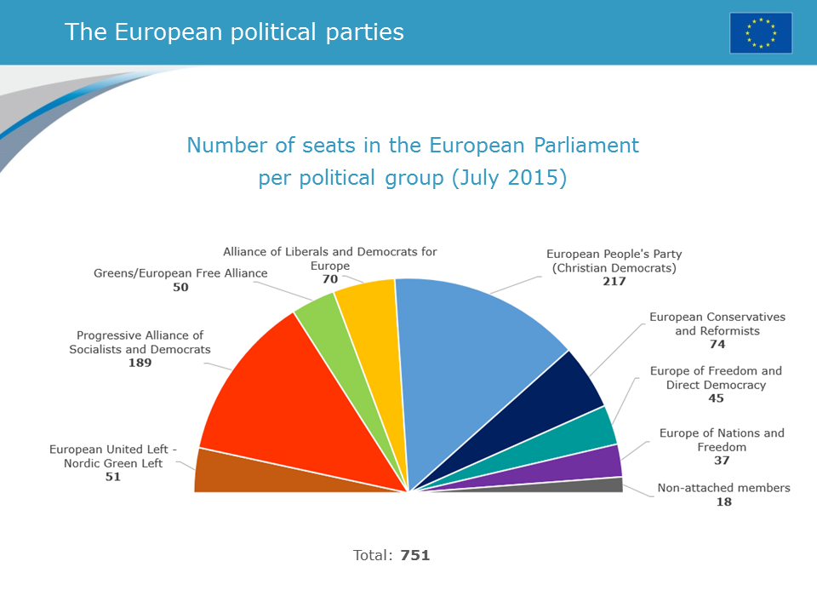

Slide 11
Perception of an EU citizen
Many different parties and groups in the EU Parliament, difficult to grasp for outsiders.
In Finland, traditional Right-Centre-Left has broken up as new parties as the “Greens” and the “True Finns” have entered national politics.
Governments have been composed of all kinds of constellations of parties.
Political views have been respected, but recently there are more harsh tones in the debate

Slide 12
Perception of an EU citizen
One key value that political parties in Finland have respected is about equity and sharing.
Especially in education, reformed completely in early 1970’s into general education for all from Grade 1 to 9. Teachers have been MEd holders since 1980’s.
“Inclusive Education”, “Life-long Learning” and “Flexible Pathways” fundamental elements.
Education is free of charge even at university level.
Health, social care services are also available to all

Slide 13
Future perspectives
Will EU provide support to all member countries to provide basic services and fundamental values?
Will EU be able to improve it’s economic status and compete on the world markets?
Can small member countries count on support in crisis or natural disaster situations? Enlargement?
Will EU manage and learn to benefit for the growing flow of migrants? And what about xenophobia?
Can we keep EU together also in the future?

